Slide 1
Feature Analysis of Breast Cancer Prediction from Cytopathology Data
Summer 2018
CSC 691- Independent Study
Instructor: Dr. Andrew H. Sung
By
Sivaditya Satya Phani Sai Ram, Pullabhotla
(w995229)

Slide 2
Table Of Contents
Introduction
About the Dataset
Pre-requisites
Input Data
Explore the Features
Feature Plot
Predictive models
Conclusions
References

Slide 3
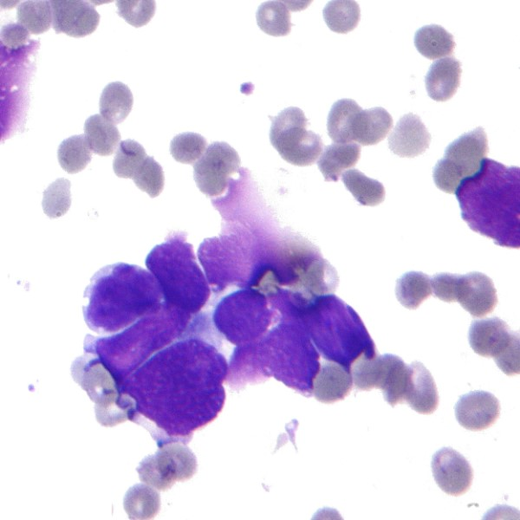
Introduction
The Breast Cancer (Wisconsin) Diagnosis dataset contains the diagnosis and a set of 30 features describing the characteristics of the cell nuclei present in the digitized image of a of a fine needle aspirate (FNA) of a breast mass.

Slide 4
Introduction Contd...
Ten real-valued features are computed for each cell nucleus:
radius (mean of distances from center to points on the perimeter);
texture (standard deviation of gray-scale values);
perimeter;
area;
smoothness (local variation in radius lengths);
compactness (perimeter^2 / area - 1.0);
concavity (severity of concave portions of the contour);
concave points (number of concave portions of the contour);
symmetry;
fractal dimension (“coastline approximation” - 1).

Slide 5
About the Dataset
This dataset is also available through the UW CS ftp server: ftp ftp.cs.wisc.edu cd math-prog/cpo-dataset/machine-learn/WDBC/
This dataset can also be found in UCI Machine Learning Repository:
https://archive.ics.uci.edu/ml/datasets/Breast+Cancer+Wisconsin+%28Diagnostic%29

Slide 6
About the Dataset Contd…
Attribute Information:
1) ID number 2) Diagnosis (M = malignant, B = benign) 3) No of attributes -32
The mean, standard error and "worst" or largest (mean of the three largest values) of these features were computed for each image, resulting in 30 features. For instance, field 3 is Mean Radius, field 13 is Radius SE, field 23 is Worst Radius.
All feature values are recorded with four significant digits.
Missing attribute values: none
Class distribution: 357 benign, 212 malignant
We will analyze the features to understand the predictive value for diagnosis. We will then create models using algorithms and use the models to predict the diagnosis.

Slide 7
Software Needed
R Markdown
R Studio
Mathplotlib
ggplot2

Slide 8
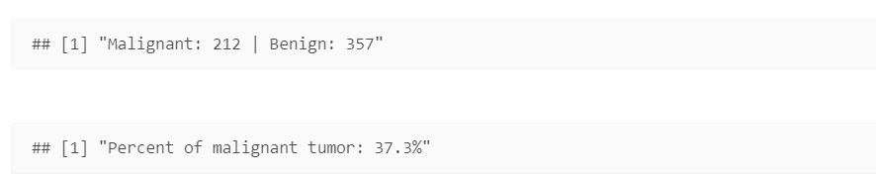
Explore the Features
On analyzing the summary of the data:
The field diagnosis has either B (benign) or M (malignant) value. Let’s check how many patients are in each category.

Slide 9
Explore the Features Contd…
The percent is unusually large; the dataset does not represents in this case a typical medical analysis distribution.
Typically, we will have a considerable large number of cases that represents negative vs. a small number of cases that represents positives (malignant) tumor.
We will analyze the features and try to understand which features have larger predictive value and which does not bring considerable predictive value if we want to create a model that allows us to guess if a tumor is benign or malignant.

Slide 10
Feature Plot
For the feature plot we will use the density plot, to represent both the values i.e. density and the degree of separation of the two sets of values, on each feature direction.
The below graphs will give an idea about the pair of features and their relation or effect.

Slide 11
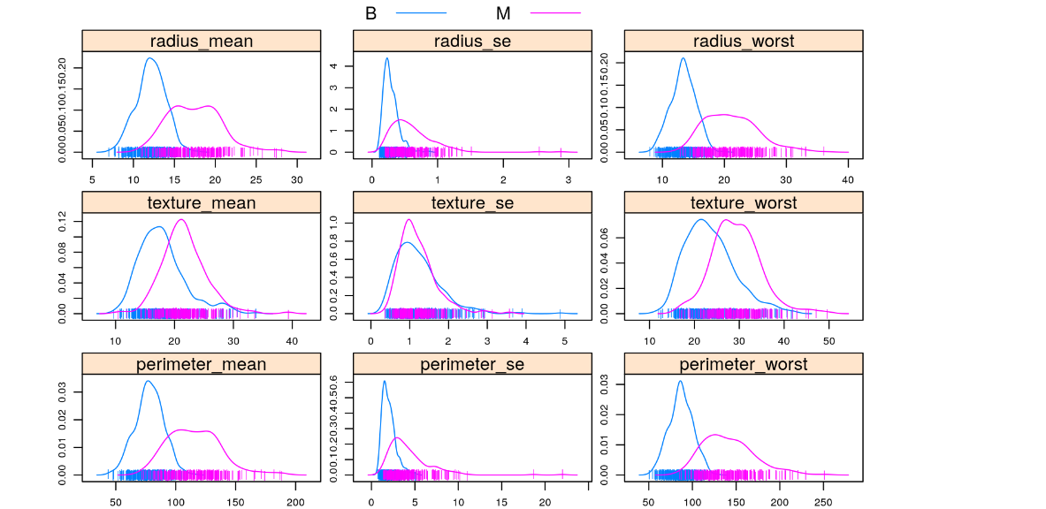
Feature Plot Contd…

Slide 12
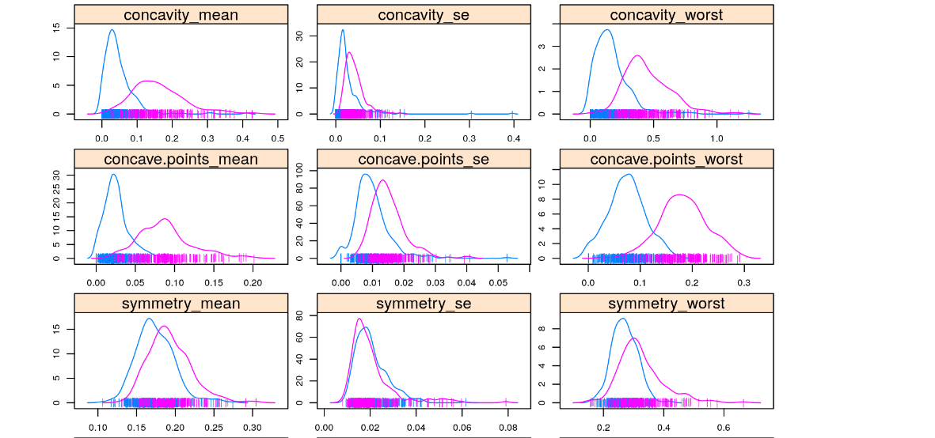
Feature Plot Contd…

Slide 13
Feature Plot Contd…
There is no perfect separation between any of the features; we do have fairly good separations for concave.points_worst,concavity_worst, perimeter_worst, area_mean, perimeter_mean. We do have as well tight superposition for some of the values, like symmetry_se, smoothness_se .

Slide 14
Predictive Models
I will use two models, Random Forest (RF), Gradient Boosting Machine (GBM)
Random forests or random decision forests are an ensemble learning method for classification, regression and other tasks, that operate by constructing a multitude of decision trees at training time and outputting the class that is the mode of the classes (classification) or mean prediction (regression) of the individual trees. Random decision forests correct for decision trees' habit of overfitting to their training set.
Gradient boosting is a machine learning technique for regression and classification problems, which produces a prediction model in the form of an ensemble of weak prediction models, typically decision trees. It builds the model in a stage-wise fashion like other boosting methods do, and it generalizes them by allowing optimization of an arbitrary differentiable loss function.

Slide 15

Random Forest Model
Let’s set the number of trees to 500. For the rest of the parameters, we will keep the default settings.
Code:
Let’s see the error evolution vs. number of trees

Slide 16
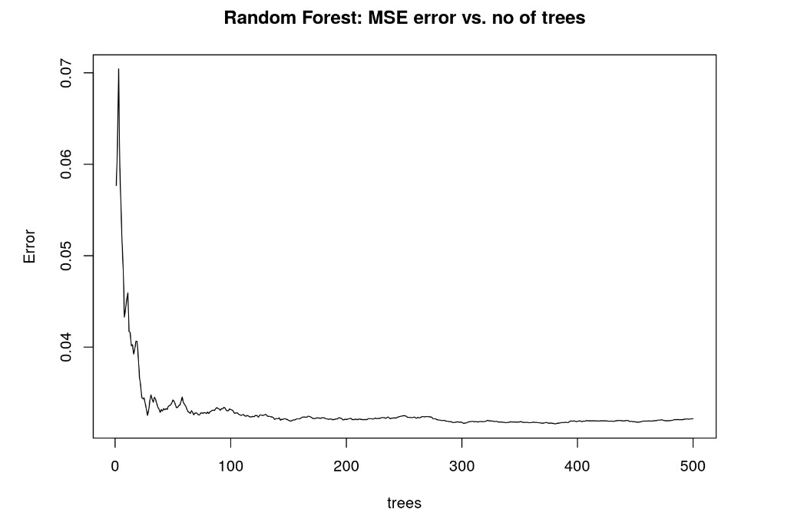
Random Forest Model Contd…

Slide 17
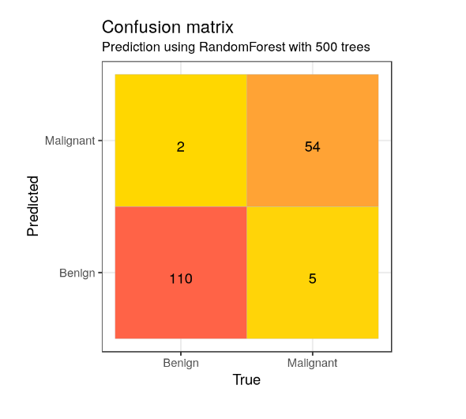
Random Forest Model Contd…
I observe that perimeter_worst, area_worst, concave.points_worst, radius_worst, concavity_mean, concavity_worst, area_se, concave.points_mean are the most important features.
AUC (Area under the curve) is: 0.949

Slide 18
Random Forest Model Contd…
Model with reduced number of features:
Let’s try to run Random Forest model with a reduced number of features, including in the features list for training only the ones with the highest importance. We reduced the number of features to 22 out of 33, by selecting only the most important, according to the feature importance evaluation using previous Random Forest model.
If we consider detection of a malignant tumor as a positive test, the result of using reduced features set is an decrease of the true positive (TP) number and increase of false negative (FP) number, while true negative and false positive numbers are unchanged.
The AUC decreased as well to 0.940 due to decrease of sensitivity and change as well of the selectivity.

Slide 19
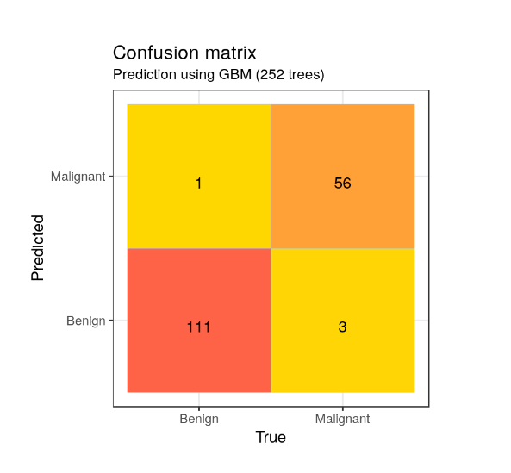
Gradient Boosting Machine (GBM)
I will use as well cross validation with 5 folds.
In order to find the best number of trees to use for the prediction for the test data, we can use gbm.perf function.
This function returns the optimal number of trees for prediction.

Slide 20
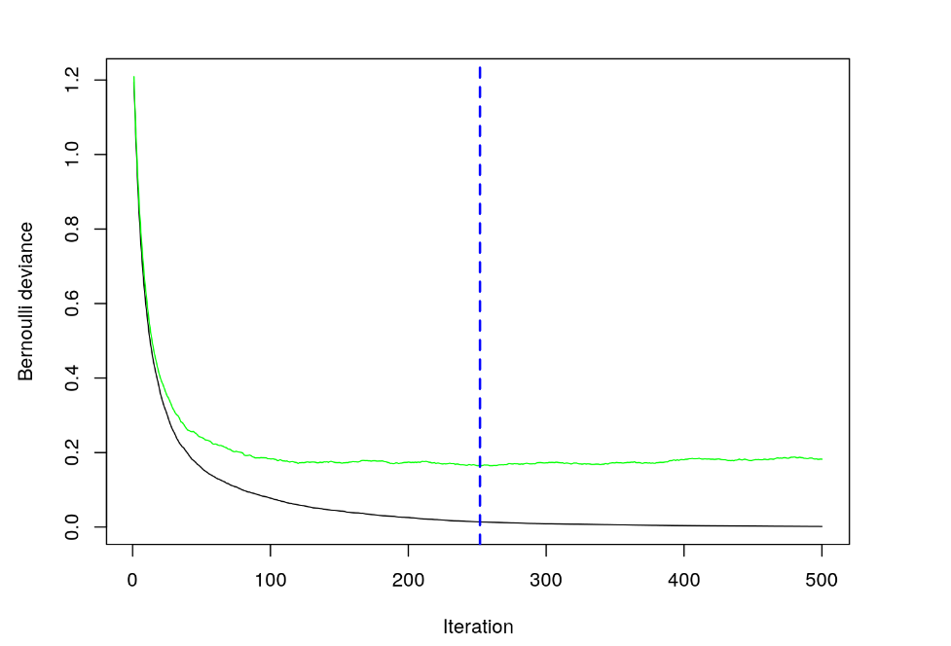
Gradient Boosting Machine (GBM) Contd..

Slide 21
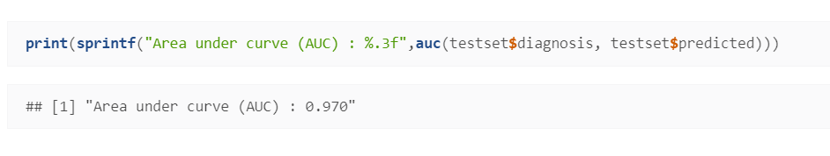
Gradient Boosting Machine (GBM) Contd..

Slide 22
Conclusion
The feature analysis show that there are few features with more predictive value for the diagnosis.
I am able to predict with good accuracy (big ROC AUC value) the malignant and benign tumors based on the two models used, Random Forest, Gradient Boosting Machine (GBM).
I am also using cross validation to decide the best model. The best prediction was obtained using GBM model.

Slide 23
References
GBM Tutorial http://allstate-university-hackathons.github.io/PredictionChallenge2016/GBM
Random Forrest https://en.wikipedia.org/wiki/Random_forest
Gradient Boosting Machine https://en.wikipedia.org/wiki/Gradient_boosting
Breast Cancer Wisconsin Data Set https://archive.ics.uci.edu/ml/datasets/Breast+Cancer+Wisconsin+%28Diagnostic%29

